Slide 1

Webscraping+EDA Project
EazyDinner Restaurant Insights
Shrutika Nair

Slide 2
About me
BBA(CA), Sinhagad Institute of Technology(Pune University)
Aspiring Data Analyst with 3+ years of experience in operations, administration, and customer coordination. Currently upskilling in data analysis with hands on experience in Python, SQL, Exploratory Data Analysis (EDA),Power BI dashboard development(Dashboarding), Web Scraping. Skilled in data cleaning, analysis, and visualization to identify trends and generate actionable insights.
Linkedin: www.linkedin.com/in/shrutika-nair-529b34239
github profile urls: https://github.com/shrutinair2027-cmd/EDA_restaurant-Data_Analysis

Slide 3
Business Objective
A restaurant chain investor from China plans to expand into the India market
The goal is to understand the Indian restaurant landscape before investment
Requires data-driven insights on:
Popular restaurant locations
Customer offers and pricing trends
Types of restaurants and cuisines

Slide 4
Problem Statement
The investor lacks structured data about the Indian restaurant industry
Market research through traditional methods is time-consuming and costly
Need to:
Analyze restaurant distribution across cities
Identify competitive trends (offers, categories, pricing signals)
Support decision-making for market entry

Slide 5
Web Scraping Methodology
Collected real-time restaurant data from (www.eazydiner.com).
Python (requests, BeautifulSoup)
Process Overview:
Used requests to fetch webpage HTML content
Parsed HTML using BeautifulSoup
Extracted required data using: soup.find_all("div",attrs={"class":"flex align-v-start flex-between padding-t-15 padding-b-15 margin-t-12 relative full-width"})
Stored extracted elements into an empty list\.
Iterated through pages to collect data from multiple sources
Data Processing:
Converted data into a Pandas DataFrame using dictionary.
Exported final dataset into CSV format for analysis using df.to_csv().
Performed regex where required.

Slide 6
Data Features(columns)
res_name
Names of all the restaurants in different cities.
location
Consist city and states information in this column.
res_offers
Offers ranges from 10 to 35 % across different restaurants.
res_states
Extracted only states column for analysis from location column.
res_cuisines
Consist info about cisines served in different restaurants.
res_prise
Price of each restaurant for two peoples.

Slide 7
Data Manipulation
Handled Duplicate values,using(df.drop_duplicates(keep="first",inplace=True)
Handles null values.
res_states had 832 null values,cuisines had 6 null values.
For res_states , cross checked with raw data and filled state using fill na and row ranges df.loc[0:407,["res_states"]]=df.loc[0:407,["res_states"]].fillna("Gujarat")
Added “city” column.df["City"]=df["Location"].str.split().str[-1]
Removed unnecessary textual information from int column using str.replace()
Converted integr/float dtype columns.

Slide 8
Analyzed
The dataset consists of restaurant information across 14 cities and 9 states in India.
The distribution of restaurants across states is as follows:
Maharashtra → 809 restaurants
Rajasthan → 763 restaurants
Karnataka → 589 restaurants
Gujarat → 407 restaurants
Telangana → 405 restaurants
Goa → 404 restaurants
Chandigarh → 286 restaurants
Punjab → 119 restaurants
Kerala → 106 restaurants

Slide 9
Price Analysis & Outliers
A box plot was used to identify outliers in restaurant pricing.
The average restaurant price is approximately ₹1200, indicating a mid-budget market trend.
The data shows the presence of upper outliers, representing high-priced restaurants.
Approximately 2.67%–2.68% (104 out of 3888 restaurants) fall above the typical price range.
re priced within the price of ₹3150, forming the primary market segment.
Prices above ₹3150 are considered upper outliers, with some restaurants going up to ₹8000.

Slide 10
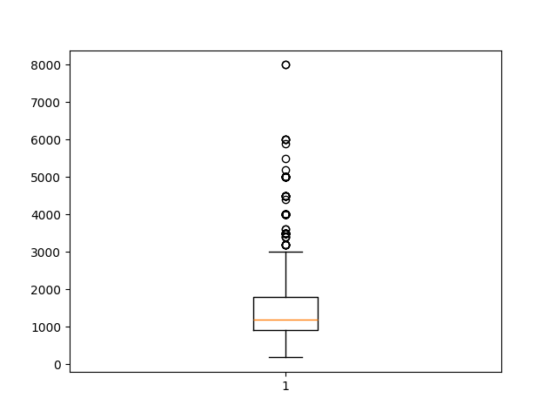
res_prise(Box Plot)

Slide 11
.
A KDE (Kernel Density Estimation) plot was used to analyze price distribution.
The distribution is positively skewed (right-skewed):
Majority of restaurants are mid-budget
Very few belong to the high-budget segment
States with the highest number of high-priced restaurants:
Maharashtra
Karnataka
Rajasthan
Telangana
Among these, Maharashtra and Karnataka show the widest price range, with restaurants priced up to ₹8000.
Performed Bar Graph to visualise it.

Slide 12
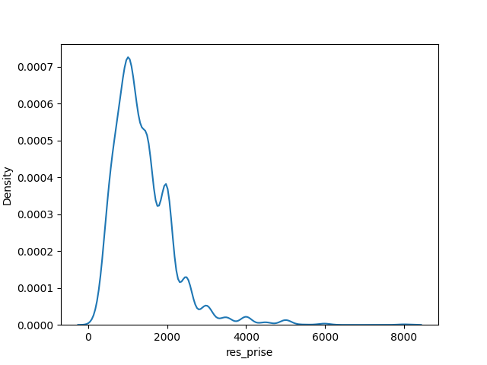
res_prise(KDE Plot)

Slide 13
Price vs Offers Analysis (Scatter Plot)
A scatter plot was used to analyze the relationship between restaurant price (res_price) and offers (res_offers).
The discount range across restaurants varies from 10% to 55%.
Most restaurants offer discounts around 25%, making it the most common offer level.
A significant number of restaurants provide offers in the range of 10% to 30%, indicating a standard pricing strategy.
Key Insights
Some restaurants in the mid-to-high price range (₹2000–₹5000) offer high discounts (above 50%), likely to attract more customers.
In contrast, premium/highest-priced restaurants tend to offer lower discounts (10%–20%), reflecting strong brand value or less price sensitivity.
Overall, there is no strong linear relationship between price and discount

Slide 14
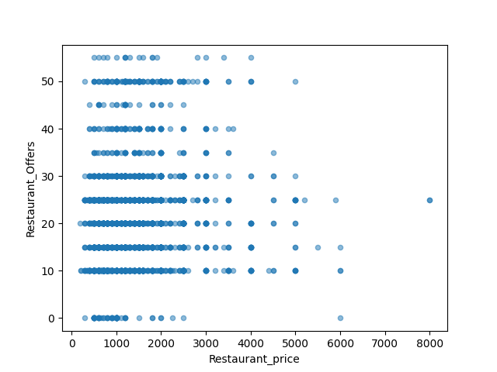
BI-Variate Analysis (res_offers and res_price)

Slide 15
Business Recommendation – Premium Restaurant Expansion
Based on the analysis, the best states to open a premium budget restaurant are:
Telangana
Rajasthan
Karnataka
Maharashtra
Among these, Maharashtra and Karnataka have the highest concentration of premium restaurants, indicating strong market potential.

Slide 16
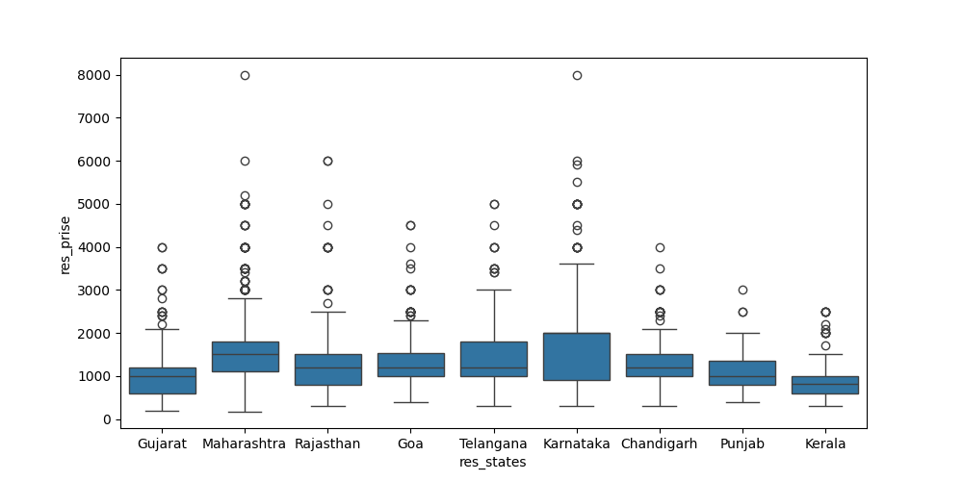

Slide 17
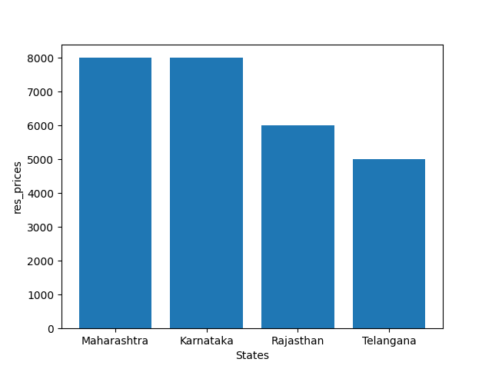
High priced restaurant bar plot.(Rs 4000 and above)

Slide 18
City-Level Insights
Within Maharashtra,
Mumbai has the highest number of premium restaurants
Indicates strong demand and competitive premium market
In Karnataka:
Bengaluru has the most premium restaurants
Average restaurant price: ₹2000
Highest price observed: ₹8000
In Rajasthan:
Jaipur has the highest number of premium restaurants
Average price: ₹1100
Highest price: ₹6000
In Telangana:
Hyderabad leads in premium restaurant presence
Average price: ₹1200
Highest price: ₹5000

Slide 19
Premium restaurant expansion should focus on Maharashtra and Karnataka, particularly Mumbai and Bengaluru, due to higher pricing potential and strong market presence, while emerging cities like Hyderabad and Jaipur offer growth opportunities.”
Popular cuisines across premium restaurants include:
Multi-cuisine
Italian
Chinese
North Indian
South Indian
Finger Food
North West Frontier
Pan Asian
Thai
Cantonese
Japanese
Awadhi

Slide 20
Business Recommendation-Mid-Budget Restaurant Analysis
Mid-budget restaurants are defined as those with prices in the range of ₹1200 to ₹4000.
A significant portion of the dataset, 54.86% , falls within this category.
This indicates that the mid-budget segment dominates the restaurant market, making it a key focus area for business expansion.
The average price of mid-budget restaurants is approximately ₹1600.
The highest observed price within this category is around ₹3600.
This suggests a stable and consistent pricing band, suitable for a broad customer base.

Slide 21
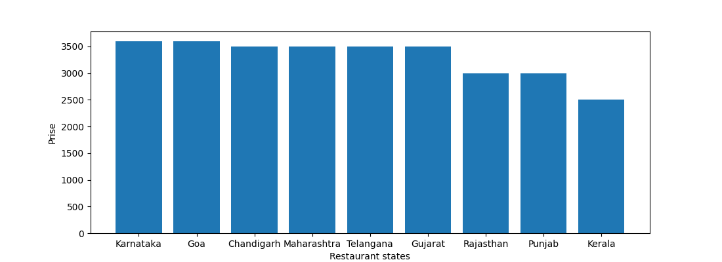
Mid-Budget priced restaurant bar plot.(₹1200 to ₹4000)

Slide 22
The mid-budget segment forms the largest share of the market (~55%), offering stable pricing and diverse cuisines, making it the most scalable and competitive segment for restaurant expansion.
Common cuisines offered in mid-budget restaurants include:
Indian
North Indian
Pan Asian
Italian
Chinese
European
Finger Food
Cocktail Menu

Slide 23
Business Recommendation-Low-Budget Restaurant Analysis
Low-budget restaurants are defined as those with prices below ₹1200.
A significant portion of the dataset, 43.38% of restaurants, falls within this category.
This shows that the budget segment forms a large share of the market, catering to price-sensitive customers
The average price of low-budget restaurants is approximately ₹800.
The price range starts from around ₹180 and goes up to ₹1200.
This indicates a wide affordability range, making it accessible to a broad customer base.

Slide 24
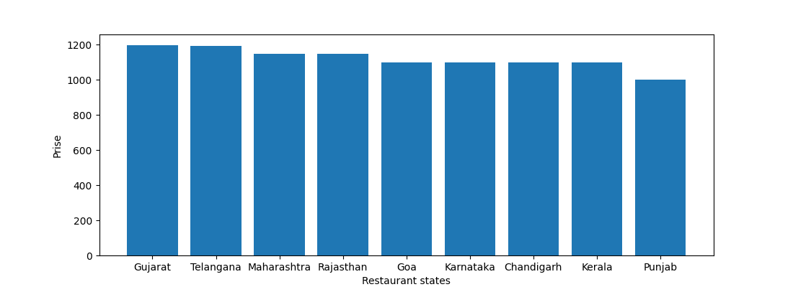
Low-Budget priced restaurant bar plot.(below ₹1200)

Slide 25
The low-budget segment captures a large portion of the market (~43%), driven by affordability and diverse cuisine options, making it ideal for high-volume, price-sensitive customers.”
The most common cuisines in low-budget restaurants include:
Indian
South Indian
North Indian
Fast Food
Italian
Continental
Finger Food
Cocktail Menu

Slide 26
Market Summary
The restaurant market in India is dominated by:
Mid-budget segment (54.86%) → Largest share
Low-budget segment (43.38%) → High volume market
Premium segment (~2.7%) → Niche but high-value market
For high profitability & brand positioning →
Enter Premium segment in Maharashtra & Karnataka
For scalability & stable demand → Focus on Mid-budget segment
Target cities like Mumbai & Bengaluru for maximum impact

Slide 27

THANK YOU

